Slide 1
ML Engineer case study
construction of a reproducible pipeline and use for turnover prediction

Slide 2
Preliminary questions & EDA
a. Which department made the highest turnover in 2016 ?
Department 127 made the highest turnover in 2016
Department | Turnover in 2016
127 | 3.340203e+07
117 | 6.322402e+06
88 | 5.654691e+06
73 | 1.960281e+06

Slide 3
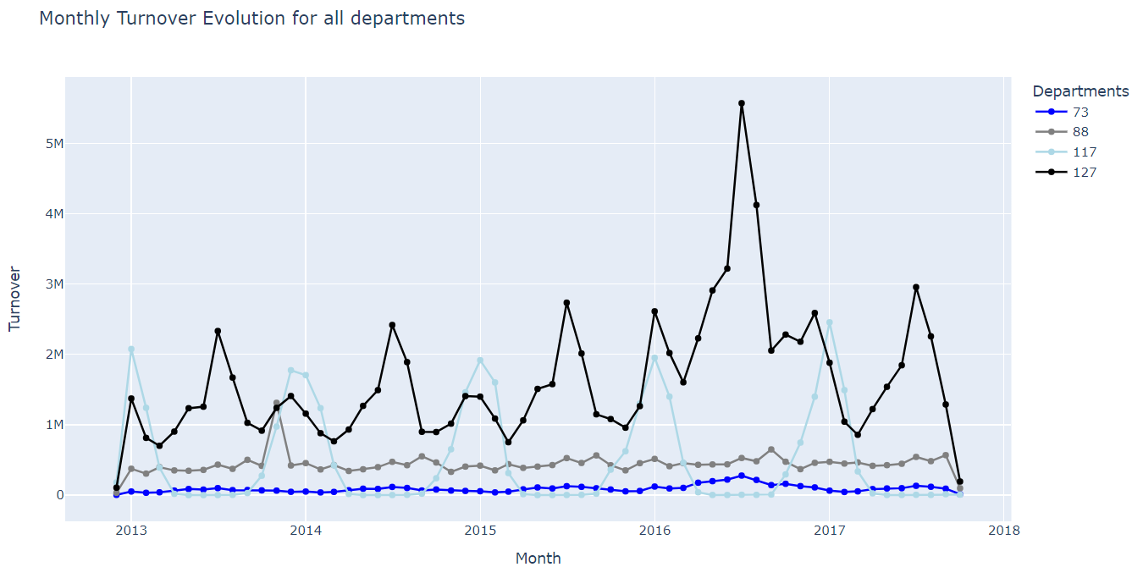
Preliminary questions & EDA
b. Based on sales can you guess what kind of sport represents department 73 ?
According to my knowledge of decathlon and some research, the sports with the highest turnover are water sports, skiing/winter sports, hiking and fitness.
Department 117 has most of its turnover between October and March, so we can assume that this department represents winter sports.
Department 127 has the highest turnover and two sales peaks: July-August and December-January. This may represent water sports, with the December/January peak corresponding to people going on winter vacations in the sun.

Slide 4
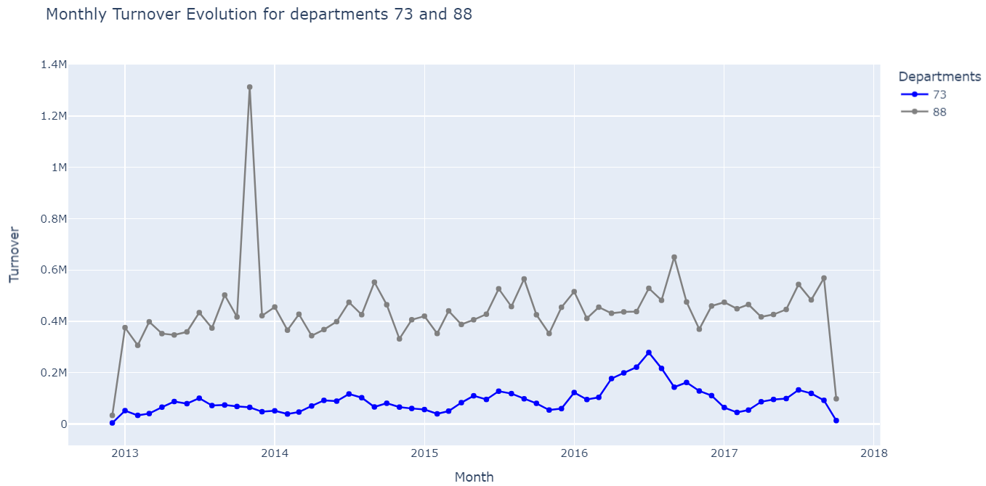
Preliminary questions & EDA
b. Based on sales can you guess what kind of sport represents department 73 ?
The last two departments, 73 and 88, have lower turnover (88 higher than 73) and are present in stores all year (unlike department 117). Sales in department 88 are very stable all year (except for a peak in November 2013), unlike department 73, which has a seasonal phenomenon in early spring and summer. With this information, we can match department 88 with fitness (similar behavior all year) and department 73 with hiking, which is more generally practiced in spring and summer, even if it remains present all year.
My guess is that department 73 represent hiking.

